Slide 1
Process identifiers
Every process has a unique process ID, a non-negative integer called PID ranges from 0 to 30,000
Kernel assigns the PID when a new process is created
Although unique, process IDs are reused.
As processes terminate, their IDs become candidates for reuse.
Special process IDs
0 swapper or scheduler(system process)
1 init process (invoked by the kernel at the end of the bootstrap procedure)
2 Page daemon (responsible for supporting the paging of the virtual memory system.)

Slide 2
In addition to the process ID, there are other identifiers for every process.
The following functions return these identifiers.
#include <unistd.h>
pid_t getpid(void);
Returns: process ID of calling process
pid_t getppid(void);
Returns: parent process ID of calling process
uid_t getuid(void);
Returns: real user ID of calling process
uid_t geteuid(void);
Returns: effective user ID of calling process
gid_t getgid(void);
Returns: real group ID of calling process
gid_t getegid(void);
Returns: effective group ID of calling process

Slide 3
fork() function
An existing process can create a new one by calling the fork function.
#include <unistd.h>
pid_t fork(void);
Returns: 0 in child, process ID of child in parent, -1 on error
New process created by fork is called child process.
This function is called once but returns twice.
It returns 0 to the child and It returns PID of the new child to the parent.

Slide 4
The reason is process can have more than one child, and there is no function that allows a process to obtain the process IDs of its children.
The reason fork returns 0 to the child is that a process can have a single parent, and the child can always call getppid to obtain the process ID of its parent.

Slide 5
Both the child and the parent continue executing with the instruction that follows the call to fork.
The child is a copy of the parent.
For example, the child gets a copy of the parent's data space heap, and stack.
Note that this is a copy for the child; the parent and the child do not share these portions of memory.
The parent and the child share the text segment

Slide 6
Current implementations don't perform a complete copy of the parent's data, stack, and heap, since a fork is often followed by an exec.
Instead, a technique called copy-on-write (COW) is used.
These regions are shared by the parent and the child and have their protection changed by the kernel to read-only.

Slide 7
If either process tries to modify these regions, the kernel then makes a copy of that piece of memory only, typically a "page" in a virtual memory system.
Variations of the fork function is vfork(2)
Linux 2.4.22 also provides new process creation through the clone(2) system call.
This is a generalized form of fork that allows the caller to control what is shared between parent and child.

Slide 8
Properties inherited by the child
Real user ID, real group ID, effective user ID, effective group ID
Supplementary group IDs
Process group ID
Session ID
Controlling terminal
The set-user-ID and set-group-ID flags
Current working directory
Root directory
File mode creation mask
Signal mask and dispositions
The close-on-exec flag for any open file descriptors
Environment
Attached shared memory segments
Memory mappings
Resource limits

Slide 9
Differences between the parent and child
The return value from fork
The process IDs are different
The two processes have different parent process IDs: the parent process ID of the child is the parent; the parent process ID of the parent doesn't change
The child's tms_utime, tms_stime, tms_cutime, and tms_cstime values are set to 0
File locks set by the parent are not inherited by the child
Pending alarms are cleared for the child
The set of pending signals for the child is set to the empty set

Slide 10
Reasons for using fork
1. When a process wants to duplicate itself so that the parent and child can each execute different sections of code at the same time. This is common for network servers the parent waits for a service request from a client. When the request arrives, the parent calls fork and lets the child handle the request. The parent goes back to waiting for the next service request to arrive.
2. When a process wants to execute a different program. This is common for shells. In this case, the child does an exec right after it returns from the fork.

Slide 11
vfork() function
The function vfork has the same calling sequence and same return values as fork.
But the semantics of the two functions differ.
The vfork function is intended to create a new process when the purpose of the new process is to exec a new program
The vfork function creates the new process, just like fork, without copying the address space of the parent into the child, as the child won't reference that address space; the child simply calls exec (or exit) right after the vfork.
Instead, while the child is running and until it calls either exec or exit, the child runs in the address space of the parent.

Slide 12
Another difference between the two functions is that vfork guarantees that the child runs first, until the child calls exec or exit.
When the child calls either of these functions, the parent resumes. (This can lead to deadlock if the child depends on further actions of the parent before calling either of these two functions.)
In the vforkeg.c program We've replaced the call to fork with vfork and removed the write to standard output.
Also, we don't need to have the parent call sleep, as we're guaranteed that it is put to sleep by the kernel until the child calls either exec or exit.
_exit does not perform any flushing of standard I/O buffers.

Slide 13
exit functions
Three functions terminate a program normally: _exit and _Exit, which return to the kernel immediately, and exit, which performs certain cleanup processing and then returns to the kernel.
#include <stdlib.h>
void exit(int status);
void _Exit(int status);
#include <unistd.h>
void _exit(int status);

Slide 14
a process can terminate normally in five ways:
1. Executing a return from the main function. this is equivalent to calling exit.
2. Calling the exit function. This function is defined by ISO C and includes the calling of all exit handlers that have been registered by calling atexit and closing all standard I/O streams. Because ISO C does not deal with file descriptors, multiple processes (parents and children), and job control, the definition of this function is incomplete for a UNIX system.

Slide 15
3. Calling the _exit, do not flush standard I/O streams.
4. Executing a return from the start routine of the last thread in the process. The return value of the thread is not used as the return value of the process, however. When the last thread returns from its start routine, the process exits with a termination status of 0.
5. Calling the pthread_exit function from the last thread in the process. As with the previous case, the exit status of the process in this situation is always 0, regardless of the argument passed to pthread_exit.

Slide 16
The three forms of abnormal termination are as follows:
1. Calling abort. This is a special case of the next item, as it generates the SIGABRT signal.
2. When the process receives certain signals. The signal can be generated by the process itself for example, by calling the abort function by some other process, or by the kernel. Examples of signals generated by the kernel include the process referencing a memory location not within its address space or trying to divide by 0.
3.The last thread responds to a cancellation request. By default, cancellation occurs in a deferred manner: one thread requests that another be canceled, and sometime later, the target thread terminates.

Slide 17
Regardless of how a process terminates, the same code in the kernel is eventually executed.
This kernel code closes all the open descriptors for the process, releases the memory that it was using, and the like.
For any of the preceding cases, we want the terminating process to be able to notify its parent how it terminated.
For the three exit functions (exit, _exit, and _Exit), this is done by passing an exit status as the argument to the function.
In the case of an abnormal termination, however, the kernel, not the process, generates a termination status to indicate the reason for the abnormal termination.
In any case, the parent of the process can obtain the termination status from either the wait or the waitpid function

Slide 18
we can differentiate between the exit status, which is the argument to one of the three exit functions or the return value from main, and the termination status.
The exit status is converted into a termination status by the kernel when _exit is finally called.
Next slide describes the various ways the parent can examine the termination status of a child.
If the child terminated normally, the parent can obtain the exit status of the child.

Slide 19
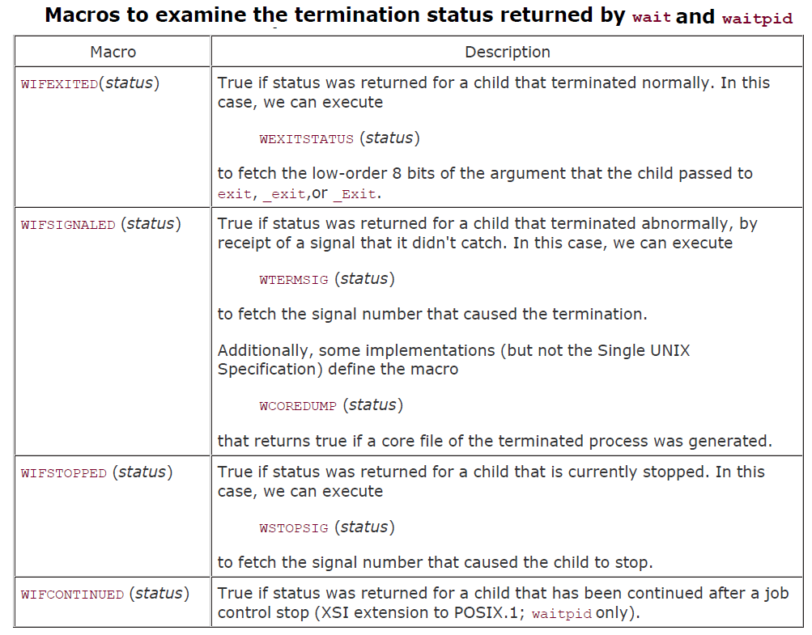

Slide 20
what happens if the parent terminates before the child?
The answer is that the init process becomes the parent process of any process whose parent terminates.
What normally happens is that whenever a process terminates, the kernel goes through all active processes to see whether the terminating process is the parent of any process that still exists.
If so, the parent process ID of the surviving process is changed to be 1 (the process ID of init).
This way, we're guaranteed that every process has a parent.

Slide 21
What happens when a child terminates before its parent.
If the child completely disappeared, the parent wouldn't be able to fetch its termination status when and if the parent were finally ready to check if the child had terminated.
The kernel keeps a small amount of information for every terminating process, so that the information is available when the parent of the terminating process calls wait or waitpid.
Minimally, this information consists of the process ID, the termination status of the process, and the amount of CPU time taken by the process.

Slide 22
The kernel can discard all the memory used by the process and close its open files.
In UNIX System terminology, a process that has terminated, but whose parent has not yet waited for it, is called a zombie.
The ps(1) command prints the state of a zombie process as Z.
If we write a long-running program that forks many child processes, they become zombies unless we wait for them and fetch their termination status.

